Slide 1






Spring Money - Loan Assist
PRODUCT TEARDOWN
To optimize Loan Assist for maximum user satisfaction and business value
User Story Unicorns
Prasanjit Sahoo
Simran Mishra

Slide 2



INTRODUCTION to
2k Followers on LinkedIn
100 100k+ mobile app downloads
Spring Money is a comprehensive platform that offers valuable insights and tools for effective personal finance management. It is a apps startup from Pune founded in 2022. The platform provides unbiased Financial Advice, covering: Investment planning, Insurance planning, Tax management, Retirement planning, Asset allocation etc.
1.7
1.7k+ Followers on Instagram
2.8
131 reviews on AppStore
Vision: To help bring about a world that confidently makes smart financial decisions
Mission: To make ‘Personal Finance Advisory’ accessible and affordable for everyone, and to provide completely unbiased Financial Advice
25-30
Target Age Group
Key Offerings and Value Proposition
Financial Planning:
Model Portfolio:
Goal setting
Analyzing current financial situation
Building a plan
Curated selection of investments designed to reflect a predetermined investment strategy .
Diversified portfolio tailored to meet specific financial goals and risk tolerance.
Competitors
Investment Advisory:
Additional Perks:
Seeking professional guidance and recommendations.
Leveraging expert insights and analysis to make informed choices aligned with individual objectives and risk preferences.
Access to powerful tools like Goal trackers, Goal calculators and Financial health checkup etc.
Also provides insurance, tax and retirement planning.

Slide 3
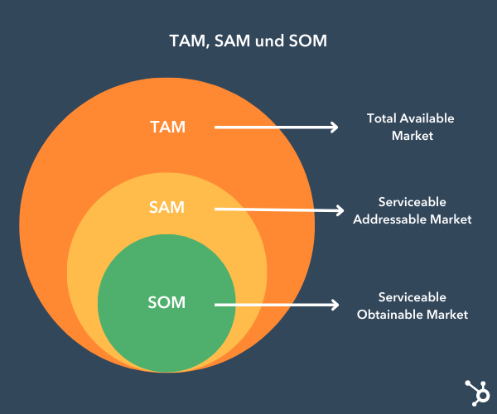
What is Loan Assist?
Loan Assist by Spring Money is designed to make getting loans easier. It helps you through every step of the loan process, from identifying your needs to choosing the best loan options, applying, and tracking the loan status. Instead of just aggregating loan offers, it provides personalized financial advice and services, working with authorized financial partners to offer tailored solutions that fit your unique financial situation.
($ 512 Billion)
Market Potential for Spring Money - Loan Assist
($ 153.6 Billion)
($ 7.68 Billion)
Key Drivers of Market Potential
Digital Adoption: Growing internet penetration and smartphone usage
Government Initiatives: Digital India, Jan Dhan Yojana, Aadhaar-based e-KYC
Consumer Behavior: Preference for online and mobile loan applications due to convenience and speed

Slide 4
Problem Statement
Why solve it now?
To optimize Loan Assist for maximum user satisfaction and business value
Market Dynamics: The personal finance market is growing rapidly, with increasing competition. Enhancing the Loan Assist feature can help Spring Money capture a larger market share by improving user satisfaction and conversion rates.
Market Positioning: A user-friendly loan process strengthens Spring Money’s market position and attracts more financial partners.
User Expectations: Consumers demand a streamlined and personalized loan process. Meeting these expectations can significantly enhance user satisfaction and loyalty.
Increase Revenue: Simplifying the loan application process and providing tailored loan options can significantly boost revenue for Spring Money by attracting more users and encouraging more loan applications.
Problem Statement Breakdown
Loan Application Confusion: Users find it difficult to navigate the loan application process, leading to frustration.
Lack of Personalization: Users feel that the loan options are not tailored to their specific financial needs, increasing dissatisfaction.

Slide 5
Competitor Analysis
BankBazaar
Paisabazaar
CreditMantri
Parameters
Use Cases | Loan Seeker - Finding the Right Loan Credit Card Applicant - Making an Informed Choice Insurance Seeker - Streamlining Insurance Needs General Financial Awareness | Seeking a Personal Loan Financing a Higher Education Building Your Credit Score Managing Multiple Credit Cards Understanding Your Creditworthiness General Financial Literacy | Free credit score check Credit monitoring services Improve credit score Loan and credit card comparison Loan application Dispute resolution
Target Audience | Pan-India reach. It caters to a broad range of age group, likely focusing on young adults starting their careers to established families managing finances. | Likely targets a range from young professionals (25-45) to established families (45-60) . Target individuals who are new to credit or have a limited credit history. | Credit seekers and builders (Age: 25-50) People who are already credit-aware and want to manage their credit health proactively. Individuals who are looking to improve their credit score for better loan terms.
USP | Free multi-bank loan approvals within 7 minutes (subject to verification). Vast comparison platform for loans, credit cards, and insurance from various providers. BankBazaar SaveMax Credit Card is a lifetime free credit card that offers a wide range of attractive rewards, cashbacks, EMI conversion and pre-approved loan facility. | Duet Credit Card offers a credit line that functions like a dual product-a credit card and instant cash transfer option. Algorithm based technology platform that provides access to multiple personal credit offers. Co-branded Paisabazaar Step Up Credit Card for credit score building India's first "Chance of Approval" feature that helps estimate approval odds with various lenders. | Provide personalized recommendations based on your credit report and financial goals. Freemium model with additional benefits CreditMantri might differentiate itself by showcasing loan and credit card options tailored to your credit profile Loan and credit card comparison with pre-approval chances Compared to global players, it cater specifically to the Indian credit system and regulations.
Disadvantage | Limited control over data, prioritising products from institutions that pay them higher, limited panel of lenders, bad interface, spam calls. | Loan options influenced by their internal algorithms and partnerships with lenders, prioritising products from institutions that pay them higher. | Limited free features, freemium model involve upselling users to paid plans, reliance on self-reported data.

Slide 6
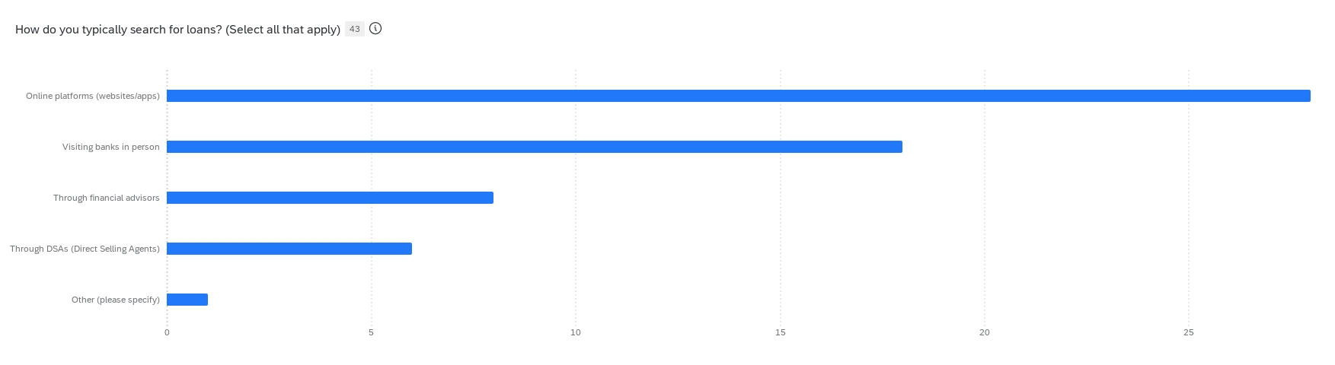
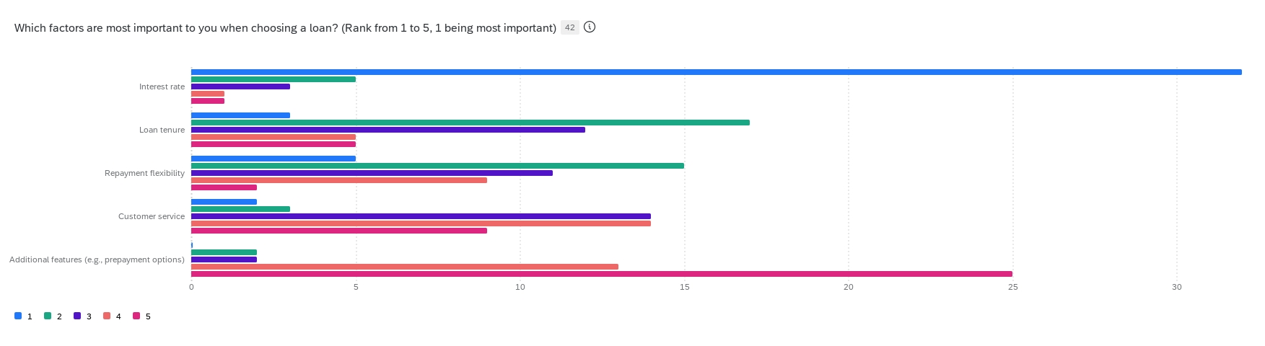
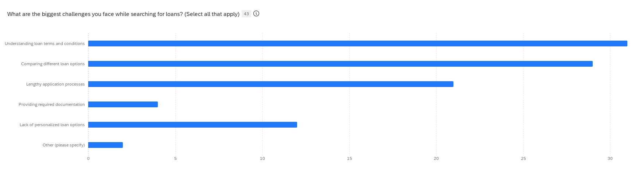
User Research (1/2)
Conducted a Qualtrics form survey, gathering 40+ responses to understand the challenges throughout the customer journey of their loan search process
Insights
Complex Loan Terms: 74% of users find understanding loan terms and conditions challenging.
Comparison Difficulties: 67% of users struggle to compare different loan options effectively.
Lengthy Application Process: 50% of users find the application process time-consuming and cumbersome.
Documentation Hassles: 10% of users face challenges in providing the required documentation.
Lack of Personalization: 29% of users feel that loan options are not tailored to their specific needs.
Trust Factors: Users determine the trustworthiness of loan providers based on reviews and ratings (63%), recommendations (61%), and transparency in terms and conditions (56%).
Platform Preferences: 45% prefer using websites, 43% prefer mobile apps, and 12% have no preference.
Feature Expectations: Key features valued by users include easy comparison of loan options (62%), a simple application process (62%), personalized loan recommendations (52%), 24/7 customer support (57%), and secure document submission (60%).

Slide 7
User Research (2/2)
Conducted 20+ user interviews to understand the challenges throughout the customer journey of their loan search process
Insights
Excerpts
Loan Search Process:
Preferred Channels: Users primarily search for loans through online platforms, bank websites, financial comparison sites, and recommendations from friends and family.
Trust Sources: Users trust official bank websites, well-known financial comparison sites, and personal recommendations for finding loan information.
Challenges Faced:
Complex Loan Terms: Many users find loan terms and conditions difficult to understand, particularly due to complex jargon and hidden fees.
Comparison Difficulties: Comparing numerous loan options is a significant challenge for users.
Lengthy Application Process: The application process is often time-consuming and involves extensive documentation.
Documentation Hassles: Providing the required documentation is a major barrier for many users.
Eligibility Issues: Understanding and meeting eligibility criteria is a common challenge.
Security Concerns: Users are concerned about the security and privacy of their financial information online.
"We often struggle to understand the complex terms and conditions of loans, which makes it difficult to make informed decisions."
​
"Comparing different loan options can be really confusing without clear and accessible information."
​
"The lengthy and cumbersome application process often deters me from completing my loan applications."
"Gathering and submitting the required documentation is a significant hassle."
"I have concerns about the security and privacy of my financial information when using online loan platforms."

Slide 8
User Research (2/2)
Insights
Excerpts
Users seek a simple chatbot that can provide real-time assistance and answer queries instantly.
There is a strong demand for clear and detailed explanations of the amortization table, breaking down principal, interest, and payment allocations.
Having easy access to this detailed information helps users understand their loans better and make informed financial decisions.
A user-friendly chatbot and comprehensive amortization details enhance trust and improve the overall user experience on the platform.
Users are highly concerned about privacy and the potential for spam calls after sharing their financial information with online loan platforms. Many users have experienced their information being sold to third parties, leading to a significant increase in unwanted and disruptive calls. This concern greatly impacts their willingness to use such services.
"A positive experience for me would involve having access to a simple chatbot that can answer my questions in real-time and provide a good explanation of the amortization table. I need the table to clearly break down every piece of information, including the principal amount, interest, and how my payments are allocated over time. This would help me better understand my loan and make more informed financial decisions. Having this kind of detailed, accessible information at my fingertips would greatly enhance my trust in the platform and improve my overall experience."
"I might feel hesitant to share my financial information with an online loan matching platform like Spring Money because I'm worried about receiving spam calls. Generally, these companies sell users' information on the internet, which leads to a flood of unwanted calls and makes it very difficult to manage. To feel secure, I need assurance that my information will be kept private and not shared with third parties."

Slide 9



User Persona (1/2)
Riya- 26, Marketing Executive
Raj- 35, Business Owner
Ankit - 23, Recent Graduate
First-Time Loan Applicants
Frequent Borrowers
Students & Recent Graduates
About | Riya is a young professional living in Bangalore. She has been working for the past 3 years and has decided to buy her first car. She needs guidance on suitable loan options and the entire loan application process. | Raj is a seasoned entrepreneur running a successful retail business in Mumbai. He frequently takes loans to manage business expansion and cash flow. He is looking for better loan options and quicker application processes. | Ankit has recently graduated with an engineering degree and is looking to pursue a master's degree abroad. He needs an education loan to cover his tuition fees and living expenses.
Pain Points | Confused by complex loan terms and conditions. Uncertain about the best loan options available. Intimidated by the lengthy and documentation-heavy application process. | Frustrated with the time-consuming loan application processes. Finds it difficult to compare different loan options quickly. Annoyed by repetitive documentation requirements for each new loan. | Struggles to find loans with favorable terms for students. Concerned about the repayment terms and interest rates. Needs help understanding the loan eligibility and application process.
Motivations | Desires to own her first car to enhance her commute and lifestyle. Wants a hassle-free loan application experience. Looking for trustworthy advice on the best loan options. | Wants to leverage loans to expand his business efficiently. Seeks streamlined and fast loan approval processes. Desires better loan terms and lower interest rates. | Aims to pursue higher education to enhance career prospects. Looking for a loan with flexible repayment options. Wants to understand the long-term financial implications of the loan.
Goals | Understand the loan terms and conditions clearly. Find the best interest rates and repayment options. Complete the loan application process smoothly and quickly. | Access a platform that offers quick and easy loan comparisons. Get pre-approved loans with minimal documentation. Find the most competitive interest rates for his business needs. | Secure an education loan with the best interest rates and repayment terms. Get clear guidance on the loan application process. Ensure a smooth and quick loan approval to meet admission deadlines.

Slide 10
User Persona (2/2)
Why focus on First-Time Loan Applicants?
Riya- 26, Marketing Executive
First-Time Loan Applicants
High Potential for User Growth:
First-time loan applicants represent a large and continually renewing market segment. As more young professionals and new graduates enter the workforce, the demand for first-time loans, such as personal loans, car loans, and home loans, remains consistently high.
Establishing Long-Term Relationships:
By catering to first-time loan applicants, Spring Money can build long-term relationships with users. Providing a positive initial experience can lead to loyalty and repeat business as these individuals progress through different stages of their financial journey and require additional financial products.
Lower Market Penetration Barrier:
First-time loan applicants often seek guidance and education about the loan process. By addressing their pain points, such as confusion about loan terms and the application process, Spring Money can differentiate itself as a trusted and supportive platform.
Word-of-Mouth and Referrals:
Satisfied first-time loan applicants are likely to share their positive experiences with peers, leading to organic growth through word-of-mouth and referrals. Young professionals are particularly active on social media and other digital platforms, which can amplify positive feedback.
Opportunity to Build Trust and Brand Loyalty:
Providing clear, transparent, and user-friendly services to first-time loan applicants can help Spring Money establish itself as a trustworthy brand. This is crucial for gaining a competitive edge in the financial services market.
Foundation for Expansion:
Successfully addressing the needs of first-time loan applicants can serve as a solid foundation for expanding to other user personas, such as frequent borrowers and students. The insights and experience gained from this segment can be leveraged to enhance services for other segments.

Slide 11
Problem Identification and Prioritization
Problem Prioritization
Complex Loans Terms & Conditions
Spam calls & misuse of information
High Turnaround Time from Banks
Users find the loan terms and conditions difficult to understand due to complex jargon and hidden fees.
Providing Accurate Loan Interest Estimation
Lengthy and Cumbersome Application Process
The application process is often time-consuming and involves extensive documentation.
High
Inconsistent Customer Support
Need a Detailed amortization Table
Users experience inconsistent support, which affects their confidence in the service.
Lengthy and cumbersome application process
Complex Loan Terms & Conditions
Spam Calls and Misuse of Information
Users are frustrated by receiving spam calls after sharing their information, as they fear their data is being sold.
IMPACT
Inconsistent Customer Support
High Turnaround Time from Banks
Low
Users face long waiting times for loan approval and disbursement from banks.
Need a Detailed Amortization Table
Users need a detailed amortization table to understand the breakdown of principal and interest over the loan period.
Low
High
Providing Accurate Loan Interest Estimation
EFFORT
Users need accurate and transparent loan interest rate estimates to make informed decisions.

Slide 12
Impact Effort Prioritization Framework (1/2)
Problem Identified | Impact | Effort | Reasoning | Solution Proposed
Complex Loans Terms & Conditions | High | Medium | Users struggle to understand complex jargon and hidden fees, which can lead to confusion and dissatisfaction. Simplifying terms will improve user comprehension and trust. | Provide clear and simple explanations of loan terms, use visual aids, and offer a glossary of terms.
Lengthy and Cumbersome Application Process | HIgh | High | The time-consuming and documentation-heavy process frustrates users and deters them from completing applications. Streamlining the process will significantly enhance user experience. | Ensure full transparency in pricing by displaying all fees upfront during the booking process. Allow digital document uploads and implement OCR technology for automatic data extraction.
Inconsistent Customer Support | Medium | Medium | Inconsistent support affects user confidence and satisfaction. Providing reliable and accessible support can enhance the overall user experience. | Offer 24/7 customer support through chatbots and multiple contact channels.
Spam Calls and Misuse of Information | High | Low | Users are frustrated by spam calls and fear that their data is being sold. Ensuring data privacy and user consent will build trust and reduce user frustration. | Implement strict data privacy policies and opt-in mechanisms for communication.
High Turnaround Time from Banks | High | High | Long waiting times for loan approval and disbursement frustrate users and can lead to loss of potential customers. Speeding up the process will improve satisfaction and retention. | Partner with banks to streamline processes, use automation for underwriting, and provide real-time updates.

Slide 13
Impact Effort Prioritization Framework (2/2)
Problem Identified | Impact | Effort | Reasoning | Solution Proposed
Need a Detailed Amortization Table | Medium | Low | Users need detailed breakdowns of principal and interest over the loan period to understand their financial obligations fully. Providing this information can enhance transparency and trust. | Offer detailed and interactive amortization tables, including downloadable versions.
Providing Accurate Loan Interest Estimation | High | Medium | Users need accurate and transparent loan interest estimates to make informed decisions. Providing real-time calculations will improve user trust and decision-making. | Develop a loan interest calculator that provides real-time estimates and detailed breakdowns.

Slide 14

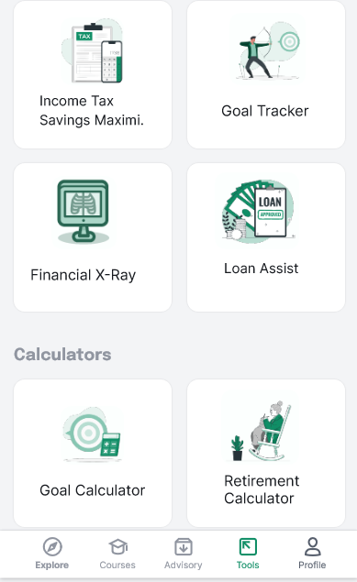
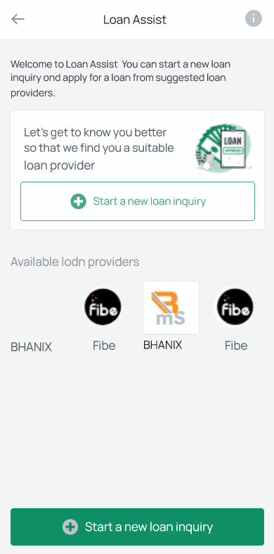
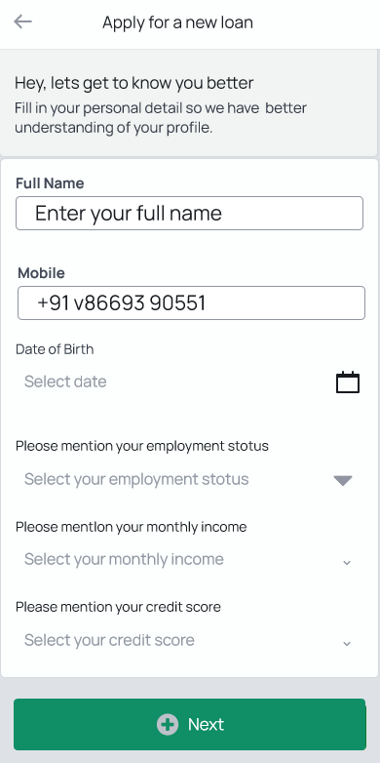
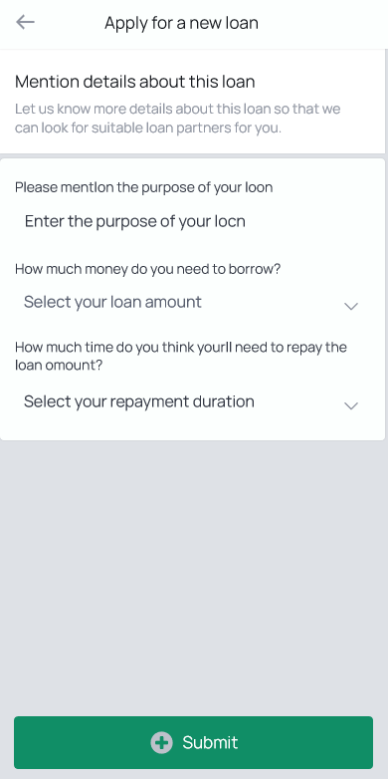
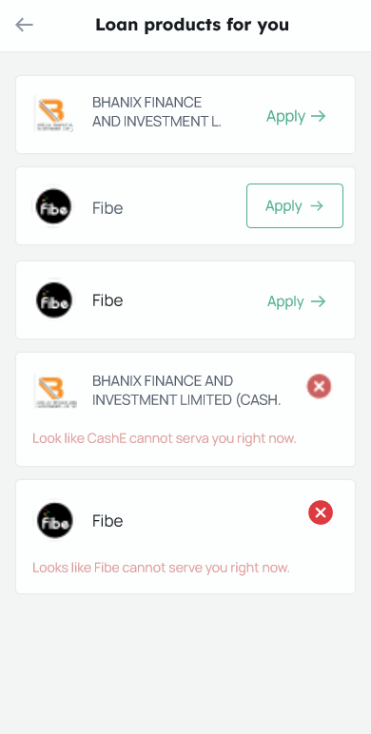


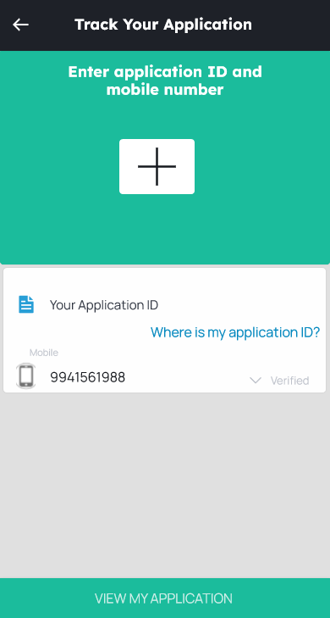
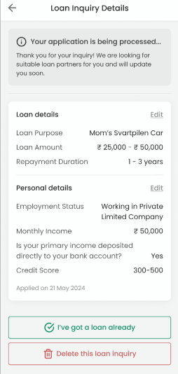
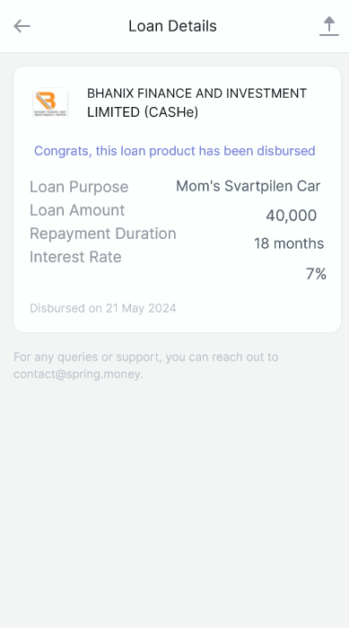
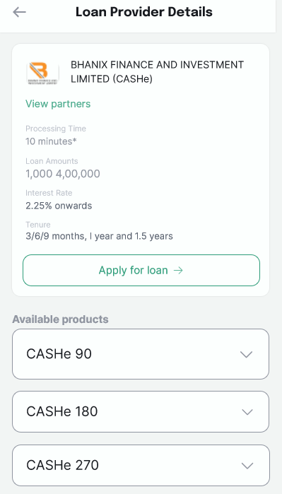

CUSTOMER USERFLOW:
Fill your loan requirements and scan all the products available
Open the app, navigate to the tools section and select Loan Assist tool
Start a new loan inquiry
Enter your details
Track your application
Apply the loan
Go through the details of loan and loan providers

Slide 15

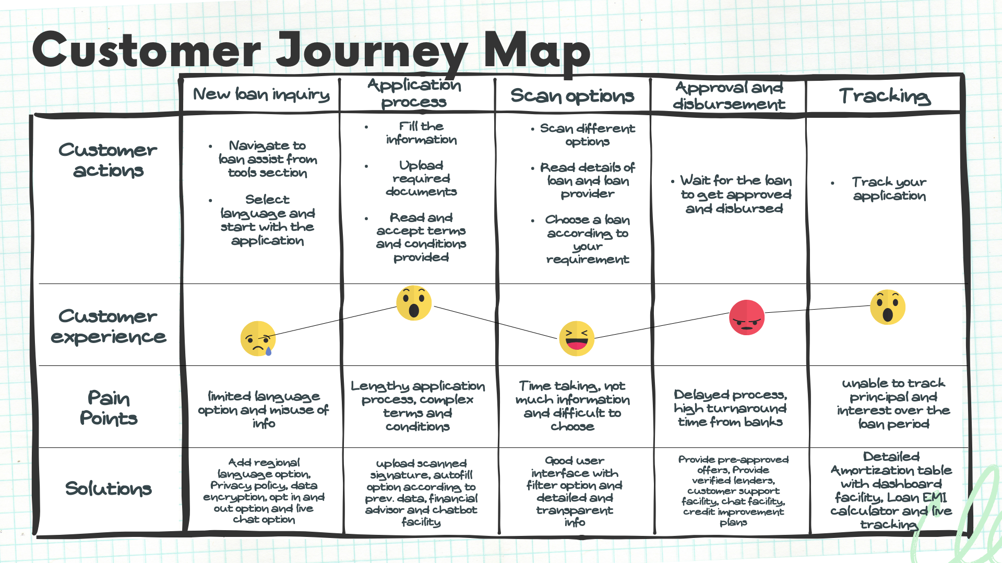

Spring Money Loan Assist- USERFLOW

Slide 16


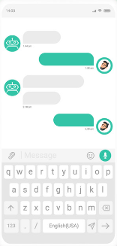

Solution 1 : AI-powered ChatBot
PROBLEM:
Inconsistent Customer Support
SOLUTION:
It will provide immediate assistance and intelligent
solutions tailored to user
needs, ensuring enhanced
customer satisfaction.
PROBLEM:
Complex Terms and Condition
SOLUTION:
Integrating Chatbot will clear the doubts of customer and make the process easier.

Slide 17
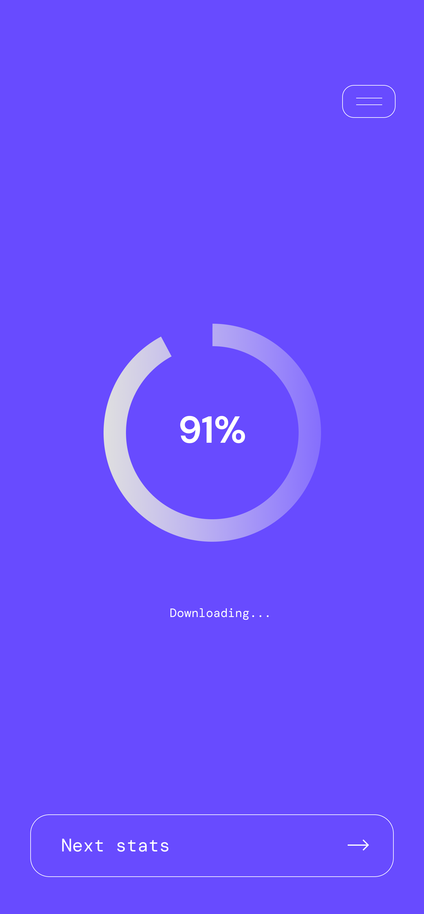

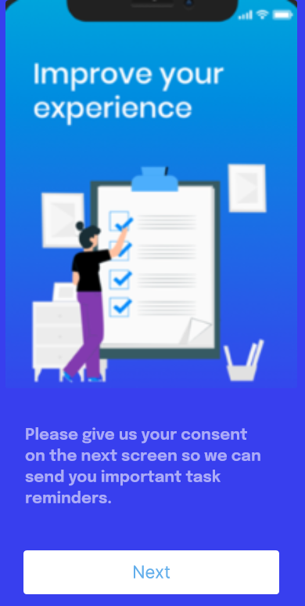
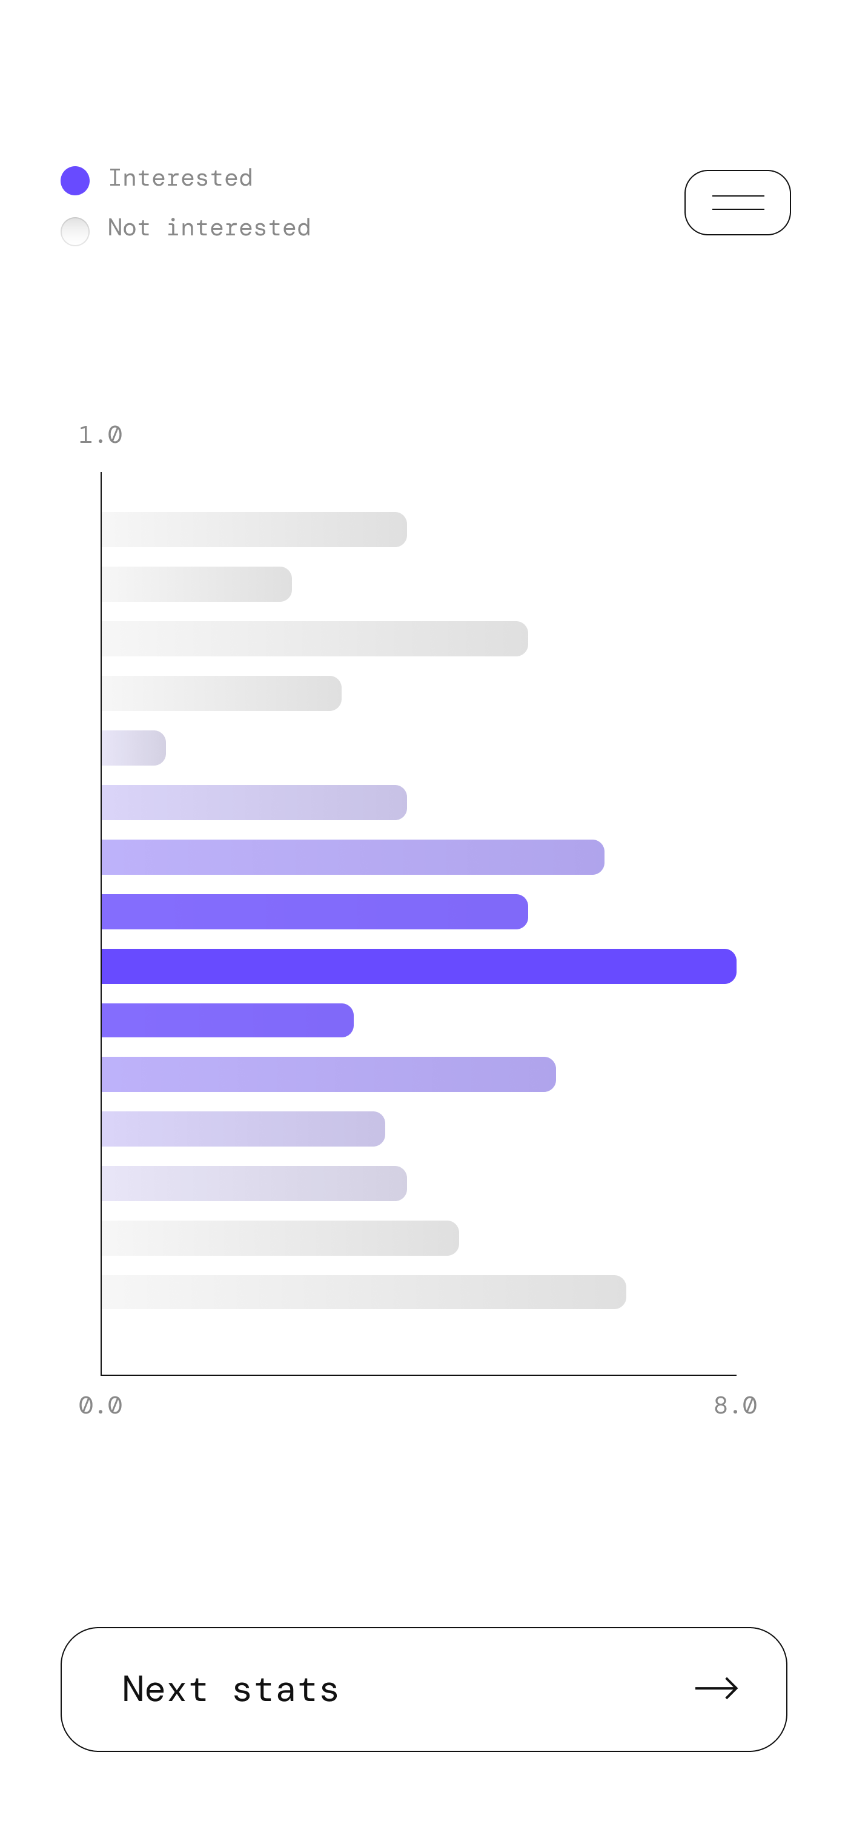



Problem: Spam calls and Misuse of information
Solution 2: Data Encryption and Protection
By implementing these opt-in and opt-out features, loan apps can ensure they are using user information responsibly and avoid unwanted communication, fostering a positive user experience. It will solve the problem of spam calls and misuse of information.
By implementing these data encryption and protection measures, loan assist apps can build trust with users and ensure the security of their financial information.

Slide 18
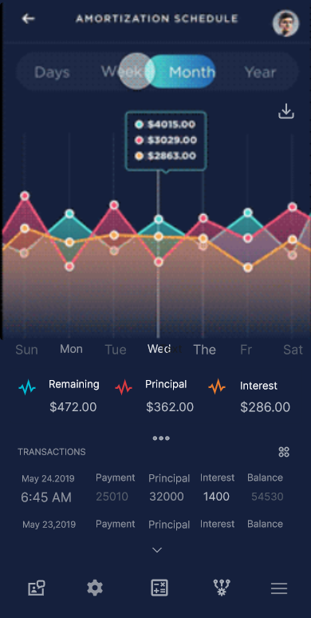


Problem: Need accurate loan interest estimation and detailed Amortization table
Solution 3: Amortization Table
Detailed and interactive amortization table including downloadable option. The table displays the following information for each payment period:
Period Number
Payment Amount
Principal Portion (amount going towards the loan balance)
Interest Portion (amount paid as interest)
Remaining Loan Balance
Users can scroll through the table to see the breakdown of payments over the entire loan term. Clicking on a specific row might highlight the corresponding breakdown (principal and interest) within the table. An option to download the amortization table as a CSV file for further analysis could be helpful.
Including a chart that visually represents the breakdown of principal and interest over time can be a valuable tool for understanding their loan repayment and making informed financial decisions.
Allowing users to access the amortization table even when offline, provided the loan details have been entered previously.
Download

Slide 19
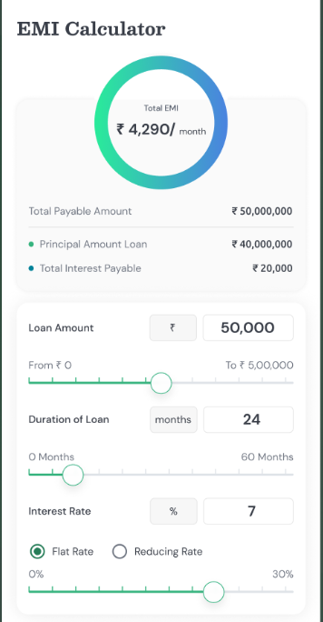
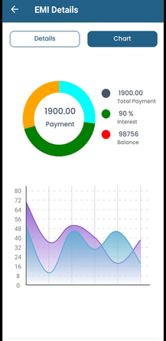





Dashboard integration and download report option to obtain real time estimation.
Loan interest calculator and detailed breakdowns.

Slide 20
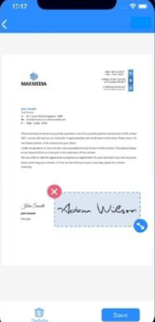
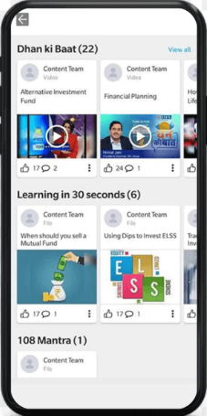
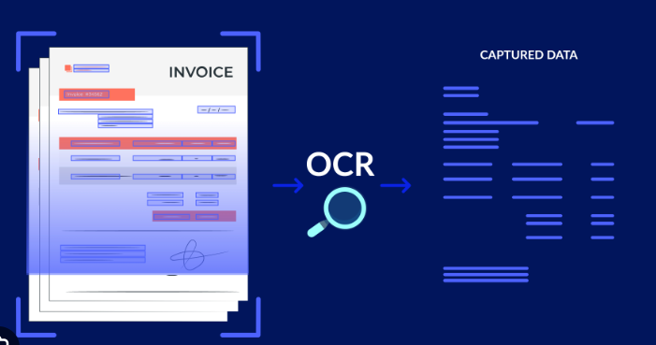


Problem: Lengthy and Cumbersome Application process
Solution 4: Easier and Faster Application
Upload scanned sign
By implementing a secure and user-controlled autofill functionality, loan assist apps can significantly improve the application process, making it faster, more accurate,
and ultimately more
user-friendly.
By leveraging OCR technology, loan assist apps can offer a faster, more user-friendly application process, and potentially faster loan approvals.
By incorporating these visual aids thoughtfully, loan assist apps can become more user-friendly, informative, and engaging. Visuals can simplify complex information, improve user comprehension, and lead
to a more positive user
experience.

Slide 21


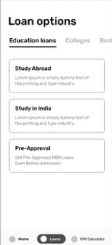
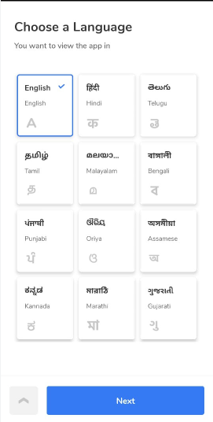
Some other suggested solutions:
Loan Tracker Post Disbursal
Regional Language Options
Educational Loan Option
A loan tracker post-disbursal can become a valuable companion for borrowers, helping them manage their loans effectively and achieve their financial goals.
Including regional language options in loan apps is crucial for financial inclusion and caters to a wider user base.
A loan assist app can offer a dedicated educational loan option to streamline the process for students seeking financial aid for their studies.

Slide 22
Metrics (1/2)
⭐North Star Metric: Quarterly Loan Application Conversion Rate
Solution | User Requirement | Metrics
Simplify Loan Terms and Conditions | Clarity: Users expect clear, easy-to-understand loan terms and conditions. Transparency: Users demand transparency in loan terms without hidden fees or jargon. | Conversion Rate: Measure the increase in completed loan applications post-implementation. User Satisfaction Score: Collect feedback on the clarity of loan terms.
Streamline Application Process | Ease of Use: Users require a simple, quick, and less cumbersome application process. Convenience: Users expect a digital application system with minimal paperwork. | Application Completion Time: Track the time taken to complete applications before and after. Drop-off Rate: Measure the decrease in application drop-offs.
Improve Customer Support | Availability: Users expect 24/7 customer support through various channels. Consistency: Users require consistent and reliable support. | Response Time: Measure the average response time of customer support. Customer Satisfaction Score (CSAT): Collect feedback on customer support experiences.
Ensure Data Privacy and User Consent | Privacy: Users need assurance that their data will not be shared without consent. Trust: Users expect transparent data handling policies. | Opt-Out Rate: Measure the number of users opting out of communications. Opt-Out Rate: Measure the number of users opting out of communications.
Reduce Turnaround Time from Banks | Speed: Users demand faster loan approval and disbursement times. Efficiency: Users expect a streamlined process with minimal delays. | Turnaround Time: Track the average time from application to loan disbursement. Approval Rate: Measure the percentage of loans approved within a standard time frame.

Slide 23
Metrics (2/2)
⭐North Star Metric: Quarterly Loan Application Conversion Rate
Solution | User Requirement | Metrics
Provide Detailed Amortization Table | Transparency: Users want a detailed breakdown of principal and interest over the loan period. Comprehensiveness: Users expect comprehensive and easily accessible amortization details. | User Satisfaction Score: Collect feedback on the clarity and usefulness of the amortization table. Usage Rate: Measure how frequently users access the amortization table feature.
Accurate Loan Interest Estimation | Accuracy: Users need precise and reliable loan interest estimates. Transparency: Users expect clear explanations of how interest rates are calculated. | Accuracy Score: Collect user feedback on the accuracy of interest estimates. Usage Rate: Measure the usage frequency of the interest estimation tool.

Slide 24

Thank you
x

Slide 25



